Slide 1

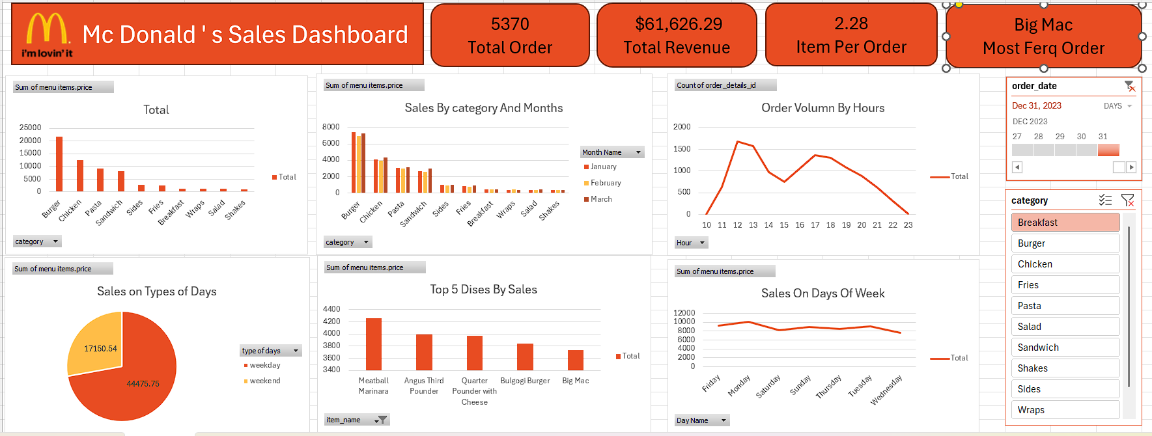
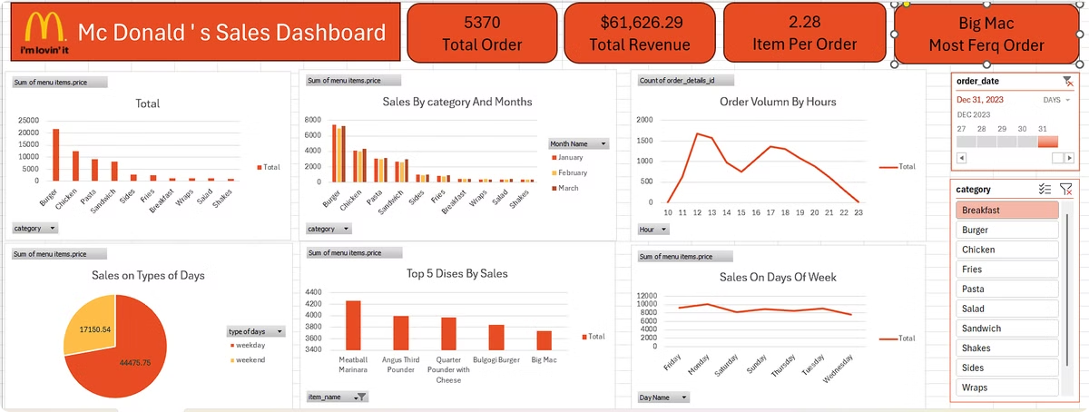

McDonald's Sales Dashboard Analysis
This presentation provides a detailed analysis of McDonald's sales data. We'll explore key performance indicators, sales trends, and top-selling items. Our goal is to provide actionable insights to optimize sales strategies and enhance overall performance.
by Varun Kumar
By Varun Kumar

Slide 2
Overall Performance Highlights
Total Orders
Total Revenue
Items Per Order
Most Frequent Order
5,370 orders were processed.
Achieved $61,626.29 in revenue.
Averaged 2.28 items per order.
The Big Mac was the most popular item.
By Varun Kumar

Slide 3
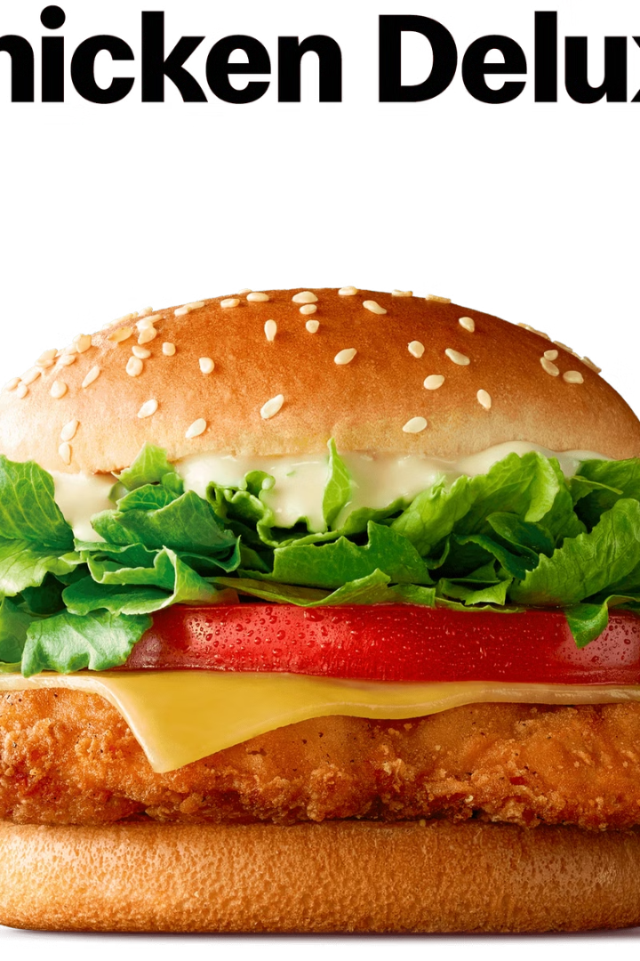
Sales by Category: Burgers Lead
1
Top Categories
2
Burger Dominance
Burgers, Chicken, and Pasta are the top categories by sales volume.
Burgers have the highest sales.
3
Chicken & Pasta
Chicken and Pasta follow closely behind burgers.

Slide 4
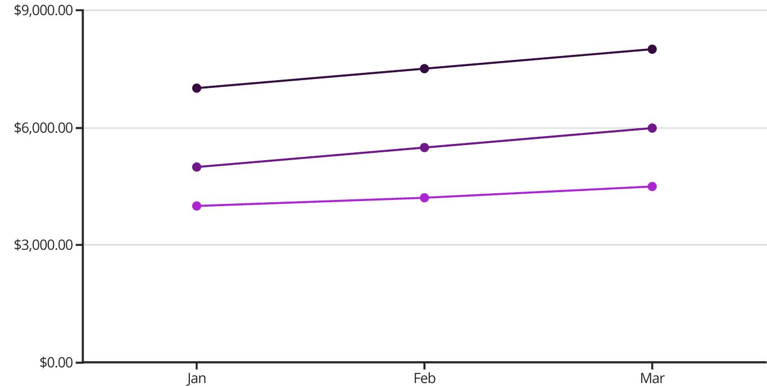
Monthly Sales Trends: Consistent Performance
Burgers
Chicken
Pasta
Sales data for January, February, and March show consistent performance. Burgers maintain the highest sales across all months.
By Varun Kumar

Slide 5
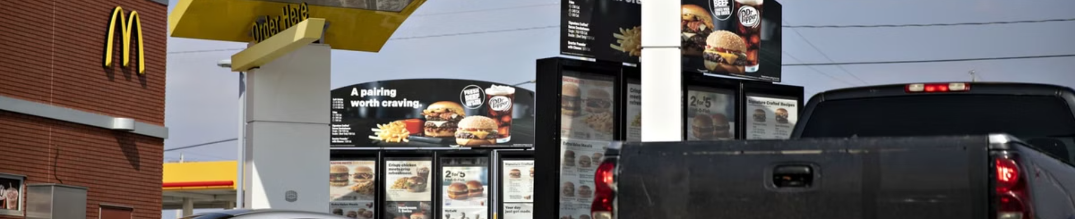


Peak Order Volume: Lunch Rush
1 PM Peak
Evening Decline
Peak order volume occurs around 1 PM.
Orders gradually decrease towards the evening.
By Varun Kumar

Slide 6
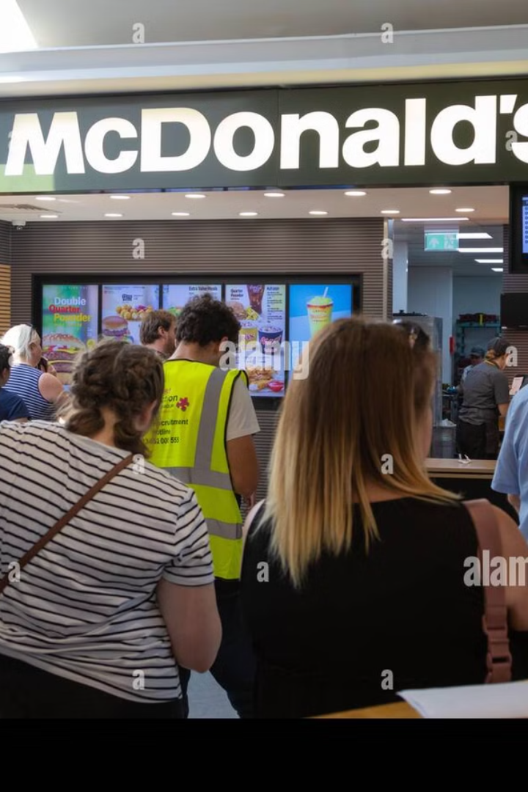
Sales by Day Type: Weekday Dominance
$44K
Weekdays
Higher sales during the week.
$17K
Weekends
Lower sales on weekends.
By Varun Kumar

Slide 7
Top 5 Dishes by Sales
1
Angus Third Pounder
2
Quarter Pounder with Cheese
3
Bulgogi Burger
The top five dishes include Angus Third Pounder, Quarter Pounder with Cheese, and Bulgogi Burger. The Angus Third Pounder leads in sales.
By Varun Kumar

Slide 8

Key Takeaways & Next Steps
Focus on Burgers
Optimize Lunch Rush
Continue to promote burger options, given their high sales volume.
Staffing and inventory should peak around lunch hours.
Weekday Promotions
Consider weekday-specific promotions to capitalize on higher sales volume.
By Varun Kumar

